Slide 1
Capstone Presentation
Jacob Posz

Slide 2
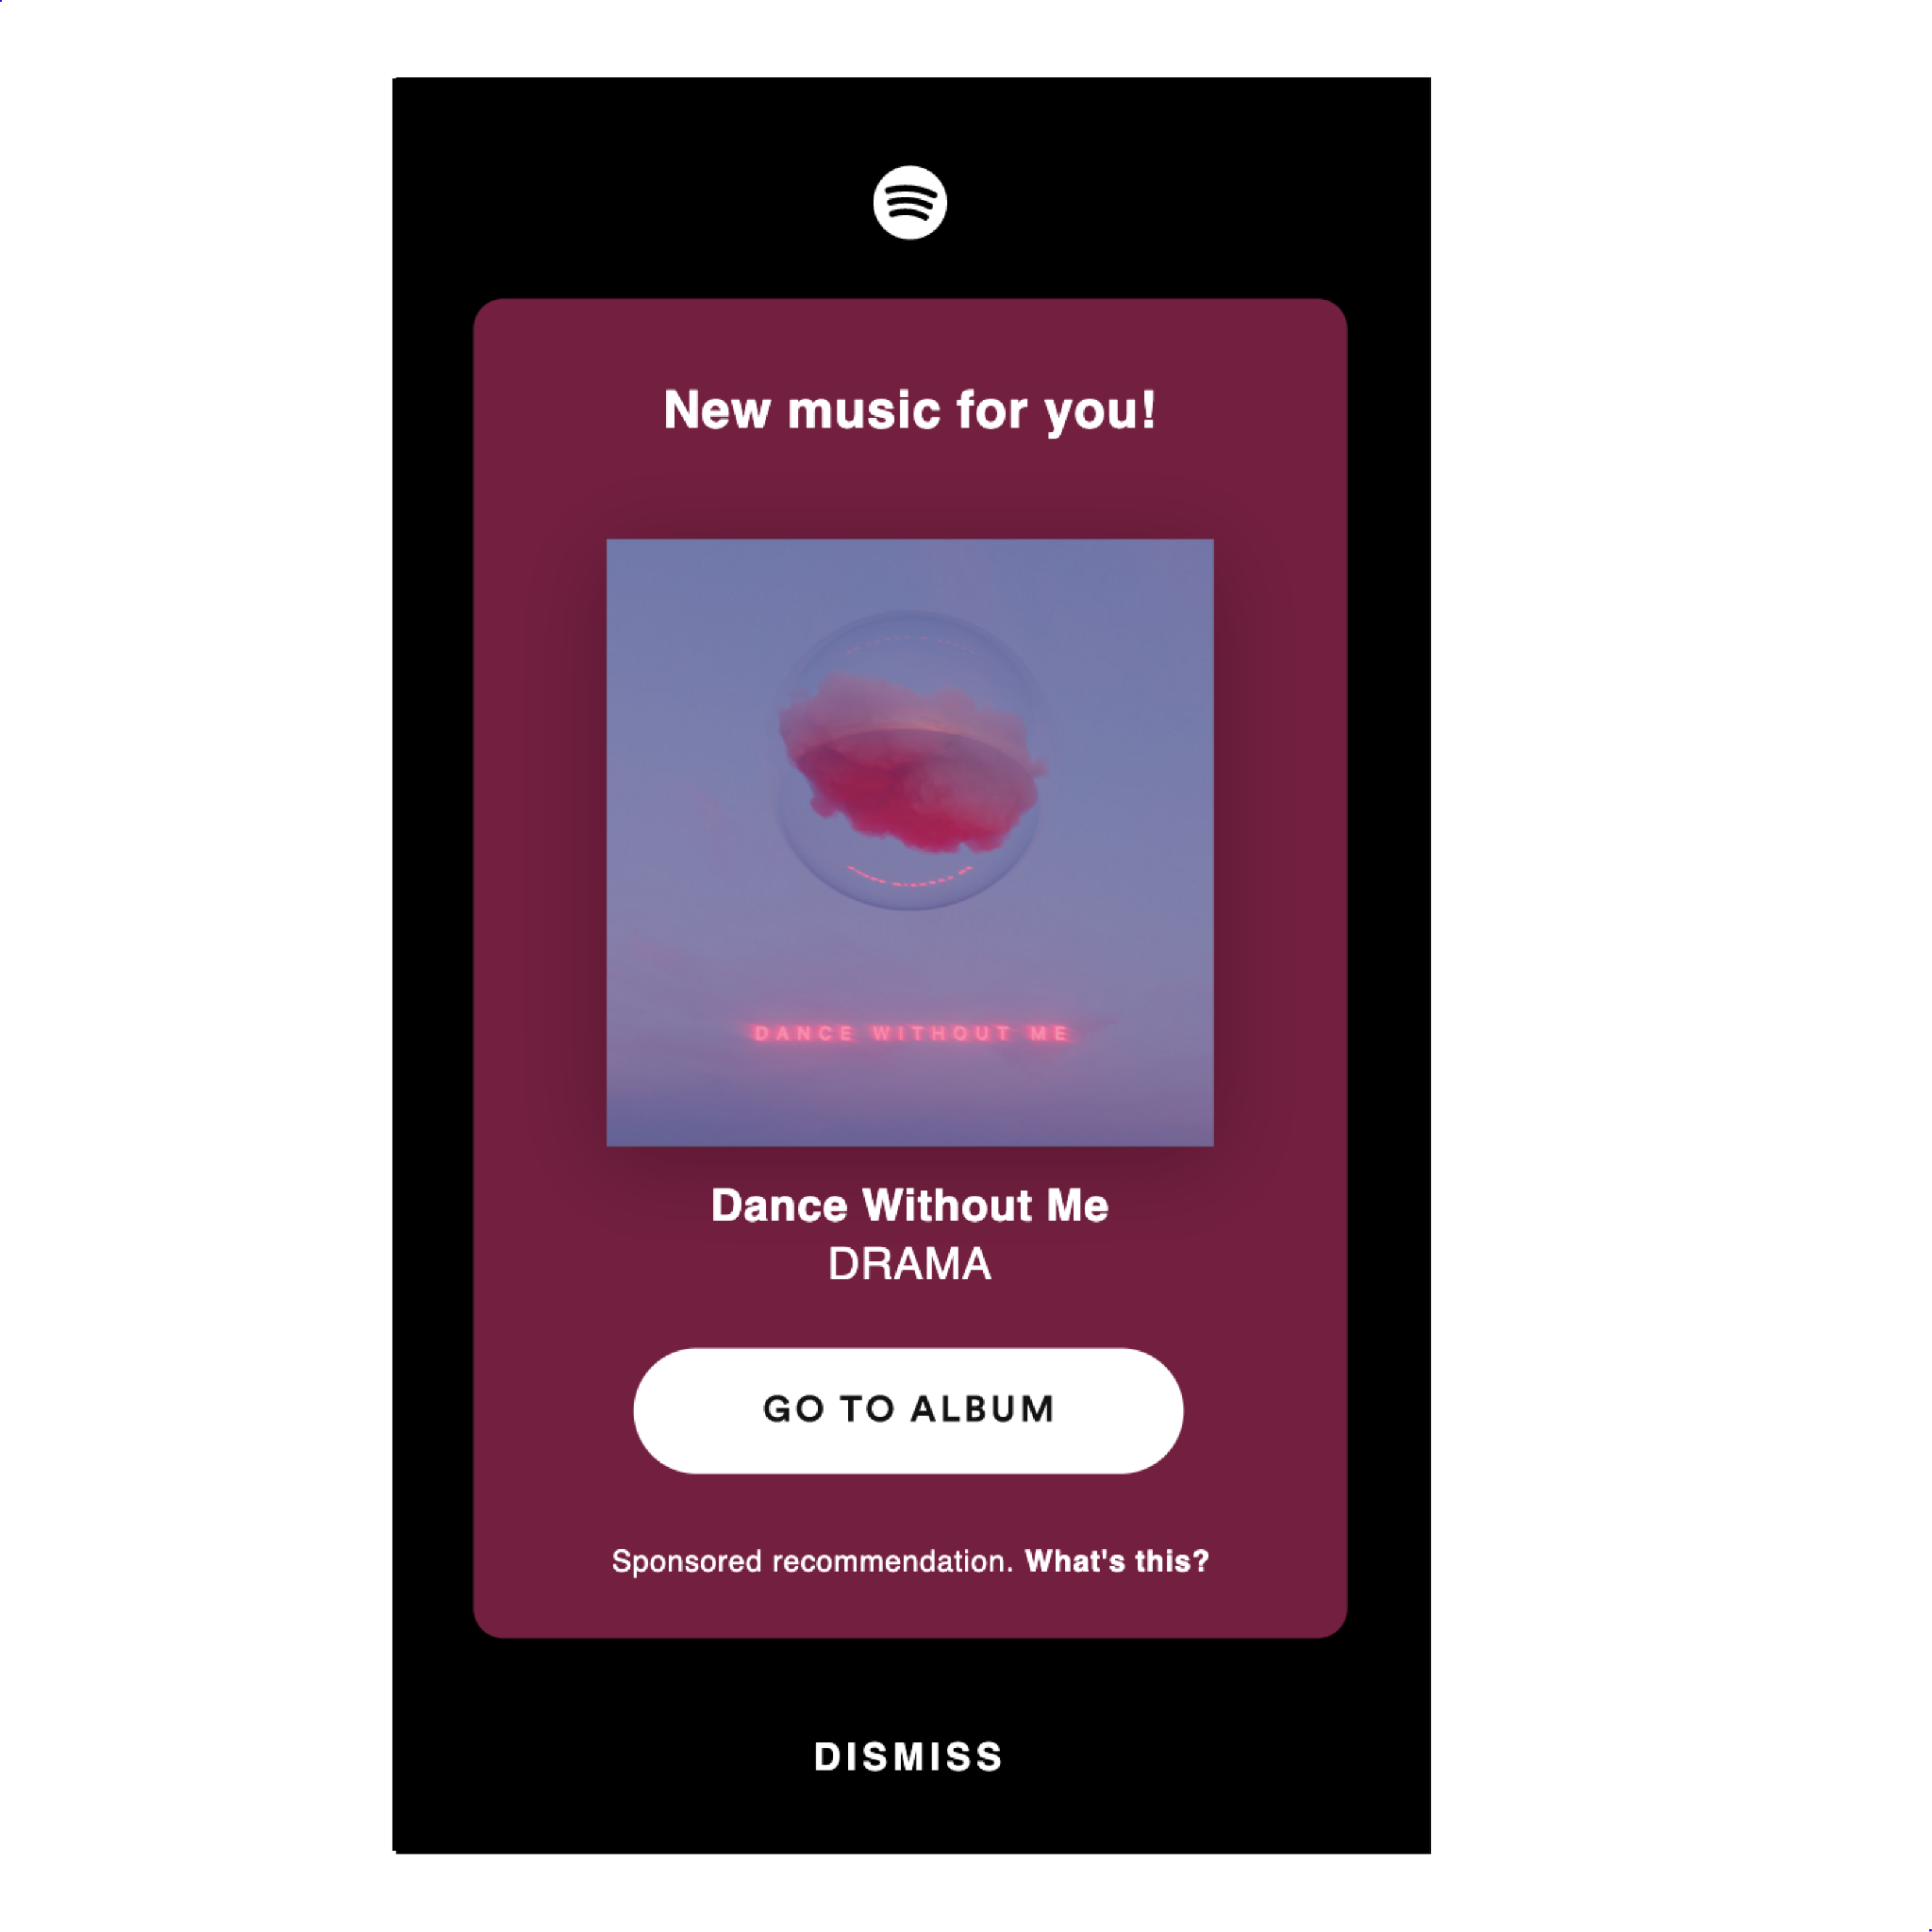
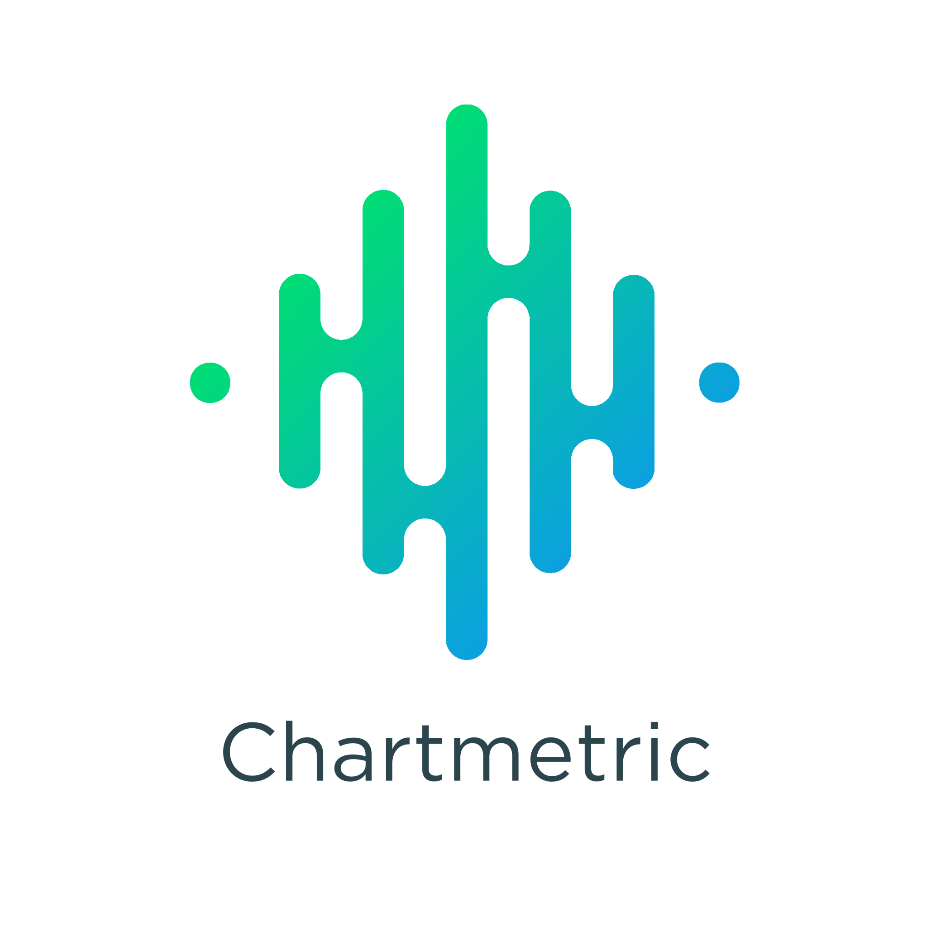
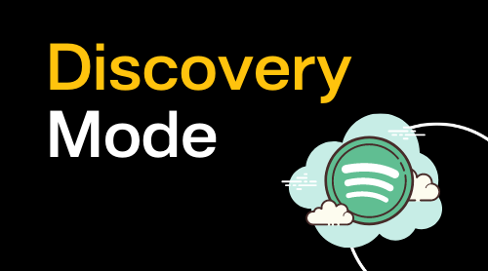
Start (Jan 31)
Release Day
Pitch Stage (Chartmetric)
Promotion Stage (Spotify’s Marquee Tool)
Growth Stage (Spotify’s ‘Discovery Mode’ Tool)
April 31
30 Days
30 Days
30 Days
Notes:
For my capstone project, I ran a single song campaign with a musician that I currently help manage using Chartmetric, Spotify’s ‘Marquee’ tool and Spotify’s ‘Discovery Mode’ tool.n
My goal was to use data analytics to correctly pitch his single (with the help of Chartmetric), promote his single (with the help of Spotify’s ‘Marquee’ tool) and grow his single (with the help of Spotify’s ‘Discovery Mode’ tool) with the eventual goal of getting the single onto a Spotify editorial playlist.
After collecting data for exactly 90 days, I’d like to share my results, what worked for me, what didn’t work for me, what I learned and what I can do better next time.

Slide 3
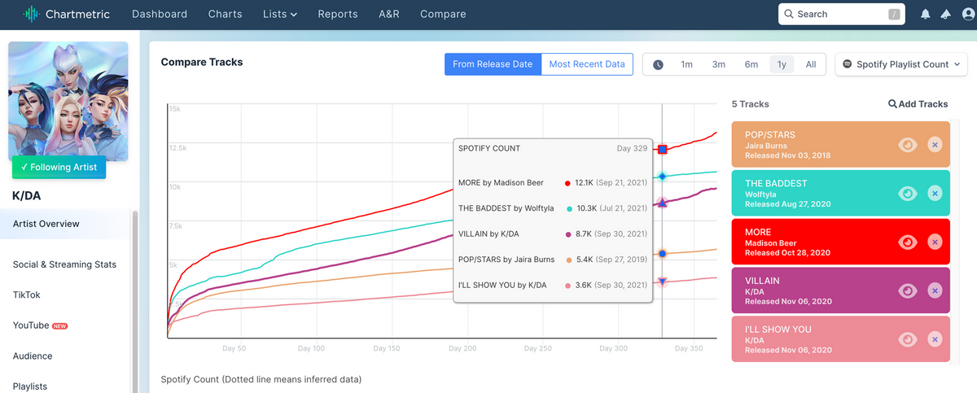
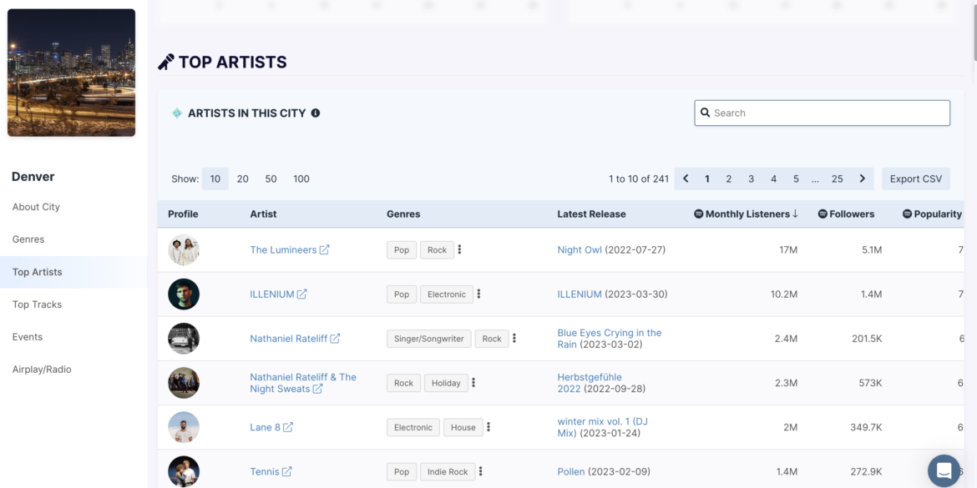
Chartmetric (Pitch Stage)
Chartmetric (pre-release) - musical database
Used it to find correct micro-genre(s) -> find the correct playlists to target
Playlist journey feature
tracks the “journey” of all songs on a targeted playlist
Found the correct Hyperpop, Indietronica and bedroom pop playlists to pitch to
Notes:
The first tool that I used was Chartmetric (pre-release and pre-pitch).
Chartmetric is primarily a musical database - I used it to figure out what micro-genre(s) my artist fell under so that I could figure out the correct playlists to target when pitching my artist’s song to Spotify (suggesting the exact name of the playlist you think the song should be on is highly recommended).
The feature I utilized the most on Chartmetric was its “Playlist Journey” feature… This feature essentially tracks the “journey” of all songs on a targeted playlist; it visualizes the tracks’ commonly occurring playlists and displays the percentage overlap between the playlists.
Through Chartmetric’s “Playlist Journey” feature, I ended up figuring out that my artist’s song fell under the micro-genre of “hyperpop,” “indietronica” and “bedroom pop”; all three of which I had never heard of / did not know existed prior to using Chartmetric.
Moreover, through the “Playlist Journey” feature, I ended up finding a few smaller Spotify curated playlists that fit my artist’s single’s micro-genres; we ended up pitching to these playlists.

Slide 4
Spotify’s ‘Marquee’ Tool (Promotion Stage)
Spotify’s Marquee tool (post-release)
We reached (people who saw the campaign) 1,712 listeners
had 233 clicks (clicks to the release)
149 converted listeners (people who streamed the release after seeing the campaign)
an 8.68% conversion rate (percentage of people streamed the release after seeing the campaign)
8.71 streams / listener (average number of active streams per converted listener who streamed the song after seeing the campaign)
a 39.6% intent rate (number of converted listeners who saved or playlisted the song after streaming)
28 total playlists adds for the song
a 30.2% save rate (number of of converted listeners who saved a track).
Notes:
The second tool that I used is Spotify’s Marquee tool (post-release).
Spotify’s Marquee tool is a full-screen, sponsored recommendation of an artist’s new release to Spotify Free and Premium listeners who have shown interest in an artist’s music and have the potential to listen more. When a listener clicks on an artist’s Marquee, they are guided to that artist’s new release—and that artist’s release alone.
With the goal of promoting my artist’s single, we saw great results from Marquee.
We reached (people who saw the campaign) 1,712 listeners
had 233 clicks (clicks to the release)
149 converted listeners (people who streamed the release after seeing the campaign)
an 8.68% conversion rate (percentage of people streamed the release after seeing the campaign)
8.71 streams / listener (average number of active streams per converted listener who streamed the song after seeing the campaign)
a 39.6% intent rate (number of converted listeners who saved or playlisted the song after streaming)
28 total playlists adds for the song
a 30.2% save rate (number of of converted listeners who saved a track).

Slide 5
Spotify’s ‘Discovery Mode’ Tool (Growth Stage)
Spotify’s ‘Discovery Mode’ tool (post-release)
More algorithmic exposure on Spotify through Spotify Radio and autoplay.
The only caveat being a lower royalty rate
Through Discovery Mode, my artist's single gained:
2,091 new listeners
2,967 streams
25 saves
15 playlist adds
155% listener lift
195% stream lift
a 1.48% intent rate
Notes:
The third and final tool that I used is Spotify’s ‘Discovery Mode’ tool (post-release).
I used ‘Discovery Mode’ for my artist to give his song more algorithmic exposure on Spotify through Spotify Radio and autoplay.
The only caveat being a lower royalty rate (however, I wasn’t too concerned about this for this project)... The results were quite staggering.
Through Discovery Mode, my artist's single gained:
2,091 new listeners
2,967 streams
25 saves
15 playlist adds
155% listener lift
195% stream lift
a 1.48% intent rate (the percentage of listeners who saved or playlisted the track after streaming it)

Slide 6
Conclusion - Did I get my Artist’s single onto an editorial playlist?
In conclusion (as of March 30th), I did not succeed in meeting my ultimate goal of getting my artist’s single onto a Spotify editorial playlist.
However, that doesn't make this project a complete failure
According to Spotify, they receive 49,000 new song pitches per day and less than 1% of them get onto Spotify editorial playlists.
I’m competing with artists signed to major labels
Although I did not succeed at meeting my ultimate goal of getting my artist’s single onto a Spotify editorial playlist, I did succeed at pitching my artist’s song to the right playlist (through researching and parsing through databases like Chartmetric), promoting it to 1,712 new listeners (through Spotify's ‘Marquee’ tool) and growing it by over 2,900 streams (through Spotify’s ‘Discover Mode’ tool).
I also set him up for downstream growth and increased traffic for future releases.
Notes:
In conclusion (as of March 30th), I did not succeed in meeting my ultimate goal of getting my artist’s single onto a Spotify editorial playlist.
However, that doesn't make this project a complete failure; I’d say that it is quite the opposite actually.
According to Spotify, they receive 49,000 new song pitches per day and less than 1% of them get onto Spotify editorial playlists. In other words, it’s extremely difficult to get onto a Spotify editorial playlist.
Moreover, I’m competing with artists signed to major labels; the major labels have marketers / managers that personally know the curators of these editorial playlists and get their artist onto them essentially automatically. Therefore, it's close to impossible to get onto one as an independent artist; however, it does happen and that is why I attempted to do so for my artist’s single.
Although I did not succeed at meeting my ultimate goal of getting my artist’s single onto a Spotify editorial playlist, I did succeed at pitching my artist’s song to the right playlist (through researching and parsing through databases like Chartmetric), promoting it to 1,712 new listeners (through Spotify's ‘Marquee’ tool) and growing it by over 2,900 streams (through Spotify’s ‘Discover Mode’ tool).
Not only did I successfully pitch, promote, and grow my artist’s single to the most listeners he’s ever seen before in a 1 month period, but I set him up for downstream growth and increased traffic for future releases.

Slide 7
Thank You

